Slide 1
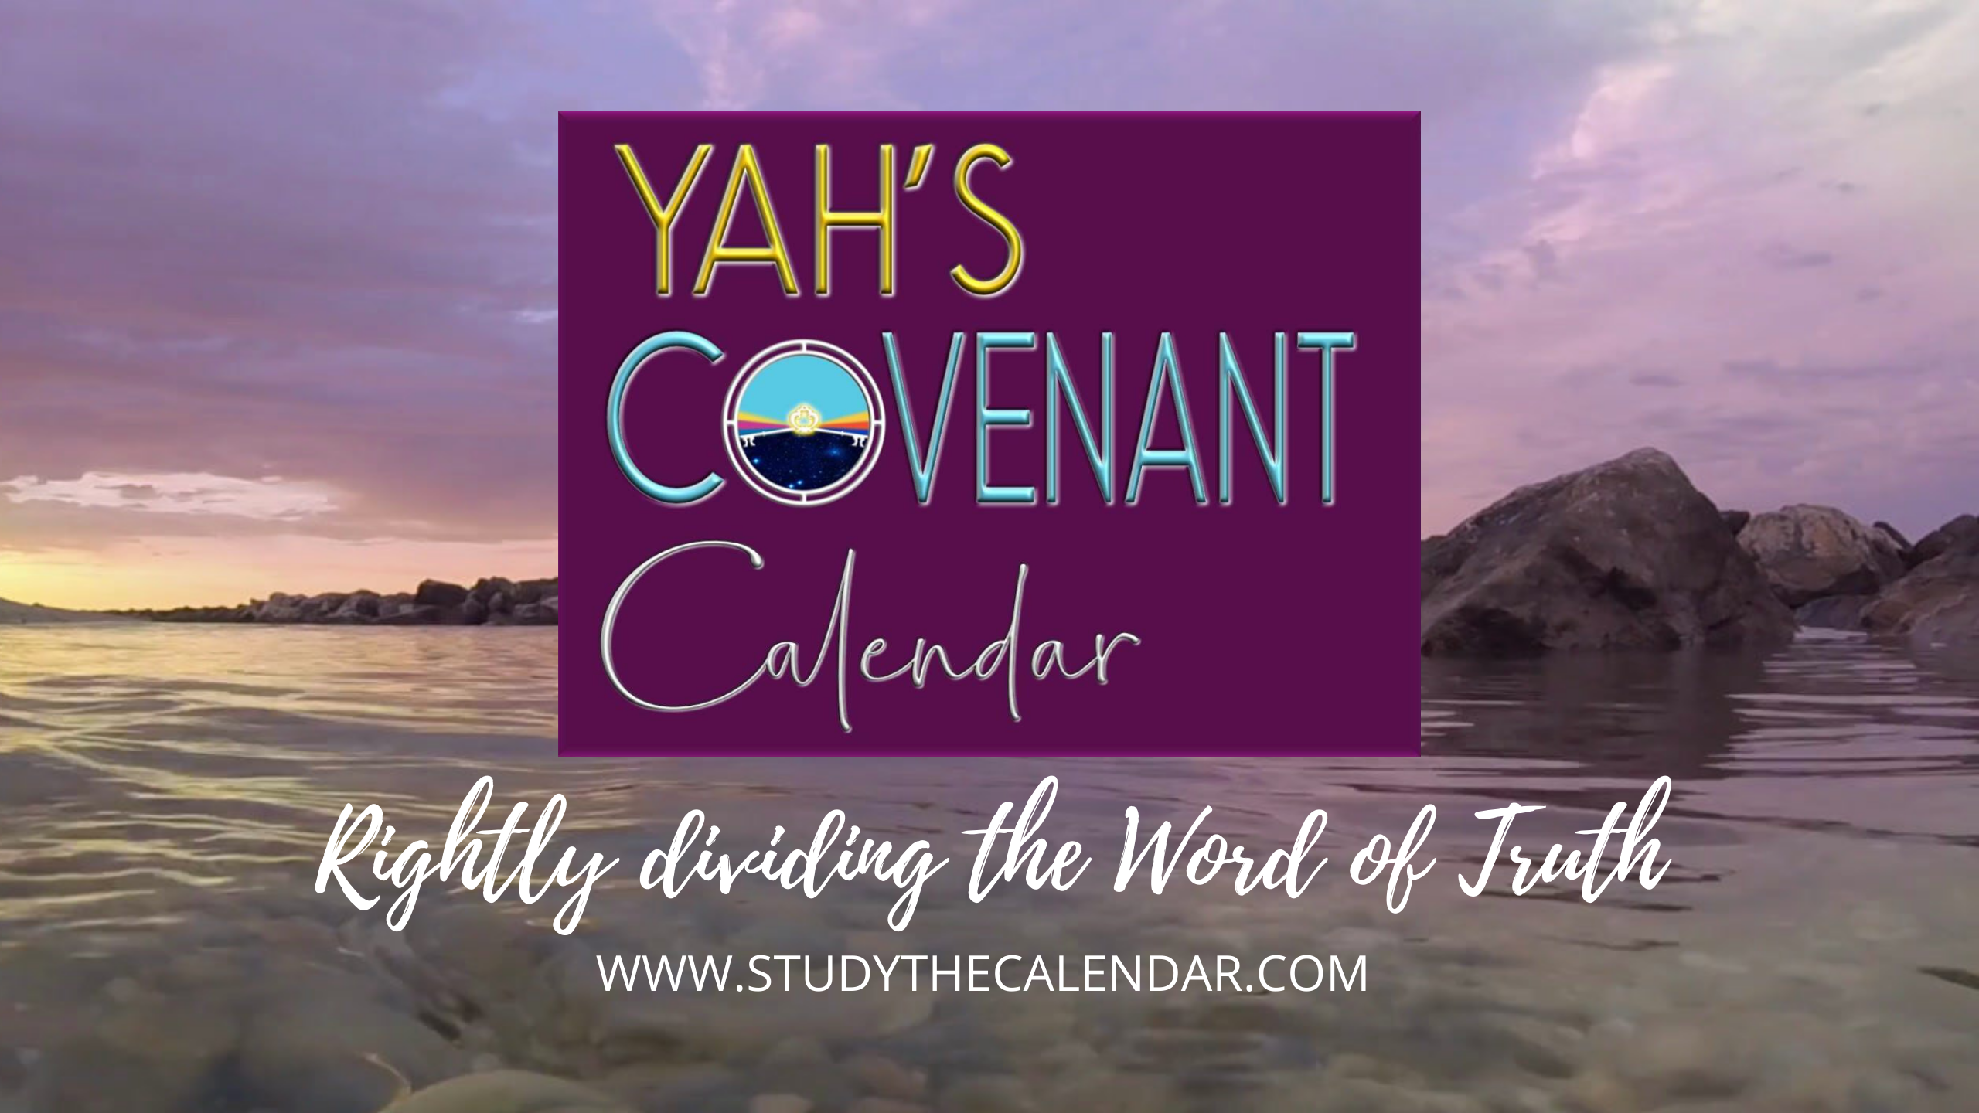
The Moon! Oh, the Moon! Pt 9

Slide 2



Everyone Wants to KNOW the
The Moon! Oh, the Moon!
Part 9: “My People have forsaken Me for the Moonth!”
Question for this lesson:
Who is really responsible for removing the Covenant Calendar keys?
2

Slide 3

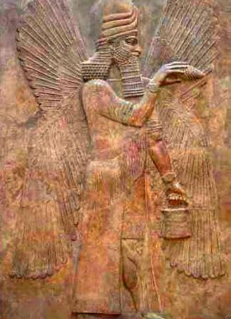
Which “no god” will gain the authority?
… the sun god?
Notes:
Sept 14

Slide 4

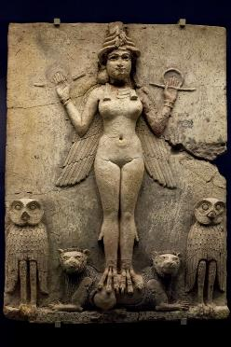
… or the moon goddess?
Semiramis
Pay attention for the answer in the next lesson!
Notes:
Sept 14-p3+

Slide 5
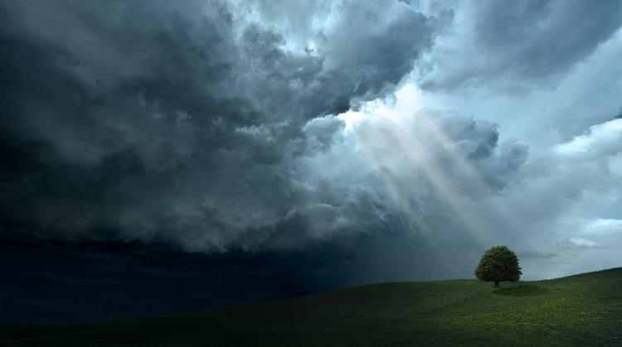
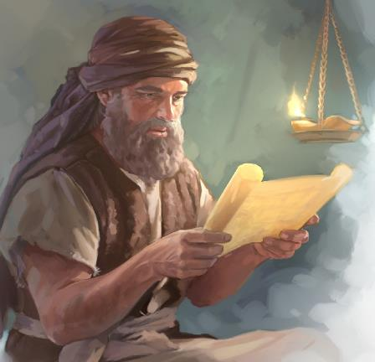

History for Judah 700 – 400 BC
Note:
This is not an exhaustive study of the history in Scripture.
Enough information will be given in this lesson to understand the overall picture.
Anyone can recognize this history by just reading the Scriptures, paying attention
to the patterns of apostasy.

Slide 6

hey, mr. graduate, we’re still on our search for who really removed the Covenant Calendar keys. are we ever going to find out?
yes, i think we will come closer to solving this puzzle today! maybe that will be a surprise, or maybe not.
today we are going
to examine the Old
Testament history
from 700 BC to 400 BC. then we also hope to
uncover the mystery of
which ‘no god’ takes calendar priority!
let’s start with a review.

Slide 7

Mapping the Topics for H2320 <chodesh>
R
E
V
I
E
W
1. H2320 Definition
H2320 <chodesh> must come into alignment with Moses & Torah as Yahuah’s “new [chodesh] month”
not Yahuah’s “new moon” or man’s agenda.
(Moon Part #5)
2. Lexicon Challenges
Examination of Theologian’s Hebrew Lexicon Study Tools: 1) Strong’s; 2) Brown-Driver-Briggs; 3) Gesenius;
4) Theological Wordbook of the Old Testament (TWOT).
(Moon Part #5)
From 1450 BC [2550 years after creation]: The Torah Calendar Instructions were for all Kings, Prophets and Leaders, up to and including Yahuah’s people today.
R
E
V
I
E
W
3. Counsel from Moses
(Moon Part #6)
4. New Moon Verses
All 20 “new moon” verses are NON-Torah references mis-translating <chodesh [H2320]> as “moon” instead of “month.” Not one verse aligned with Torah instructions!
(Moon Part #6)
7

Slide 8
Mapping the Topics for H2320 <chodesh>
R
E
V
I
E
W
R
E
V
I
E
W
5. 1611 KJV Translators
Investigation of 1611 KJV Translators and their treatment of H2320 <chodesh> in Isaiah 47:13.
Findings: their mis-translation was deliberate!
(Moon Part #7)
6. Bible Translations
Examination of 10 different translations (of many) that clearly give the true interpretation for the context of Isaiah 47:13.
(Moon Part #7)
Examination of 3 Bible Commentators for their insight into the proper meaning and history of
Isaiah 47:13. They agree with proper context.
R
E
V
I
E
W
7. Bible Commentators
(Moon Part #7)
NEW
Mapping the Topics for Tanach History
The Old Testament history search began with Adam to Noah to see if any patriarchs were involved & trapped in the worship of ‘no gods.’
8. Adam to Noah
(Moon Part #8)
8

Slide 9
Tanach is spelled right! Sometimes as Tanakh.
Mapping the Topics for Tanach History
9. Flood to Nimrod
Nimrod was worshipped as a ‘no god.’ This happened only after he had died. Semiramis was worshipped as a goddess while yet alive.
(Moon Part #8)
R
E
V
I
E
W
NEW
L
E
S
SON
10. Terah & ‘no gods’
Terah and his family lived in the area of Babylon called Ur of the Chaldees where ‘no gods’ were worshipped. Terah manufactured moon idols.
(Moon Part #8)
11. Egypt & ‘no gods’
Egypt also worshipped many ‘no gods’ while Yahuah’s people were in bondage there. Mount Sinai was located in moon worship territory.
(Moon Part #8)
12. Joshua & ‘no gods’
Joshua trained under Moses, the last Melchizedek priest. His mandate was to rid the land of idols. He pleaded with the people to follow Yahuah.
(Moon Part #8)
9

Slide 10
Mapping the Topics for Tanach History
13. Two main ‘no gods’
There are 1000s of ‘no gods’ worshipped in this world today. The two main ‘no gods’ that contend for divine worship are the sun & moon.
(Moon Part #8)
R
E
V
I
E
W
NEW
L
E
S
SON
14. Groves & a Garden
The “groves and trees” were specifically designed for the worship of the moon goddess. The worship of a ‘no god’ began with a tree in the Garden of Eden!
(Moon Part #8)
15. Judges to 700 BC
From the heels of Joshua’s excellent leadership, Judges (and up to 700 BC) documents the seriousness of the worship of ‘no gods’ … using pagan calendars.
(Moon Part #8)
16. Part #8 Conclusion
This study is best conducted by placing everything in order of date to see the picture of exactly what is happening. Biblical patterns will be evident.
(Moon Part #8)
10

Slide 11
Mapping the Topics for Tanach History
17. Judah Information (1)
A short section with some general foundational information on the brother Judah and the tribe of Judah with connections to Benjamin and Simeon.
R
E
V
I
E
W
NEW
L
E
S
SON
(Moon Part #9)
18. Sundial Introduction
Date: 701-699 BC. Hezekiah was given two signs for a huge turning point in history. Was asking for the sun to go back the right choice?
(Moon Part #9)
19. Historical Records
Velikovsky & Wong document calendar history of 30 ancient civilizations around 700 BC when the year length changed from 360 days/year.
(Moon Part #9)
20. Hezekiah - Nehemiah
700-400 BC: Sundial miracle was Yahuah’s deliberate attempt to move His people back to His ways of worship. Nehemiah - last great reformer.
(Moon Part #9)
11

Slide 12
Mapping the Topics for Tanach History
21. Judah Information (2)
New Testament Era: A short section with some general foundational information on the tribe of Judah, Judas [Judah] the Betrayer and non-Jews.
R
E
V
I
E
W
NEW
L
E
S
SON
(Moon Part #9)
22. Naphtali & Galilee
A short investigation between Naphtali & Galilee in relation to Judea. Is the Lawgiver really from Judah? Did these areas honor Yahuah’s Covenant Calendar?
(Moon Part #9)
23. Jerusalem & Pella
From the cross to 70 AD and up to 100 years+ later, what happened to Paul and the apostles for honouring Covenant Torah and Calendar?
(Moon Part #9)
24. Audience Participation
What are your thoughts on how the Covenant Calendar keys were lost and by whom? Did the OT history clarify where the troubles originated?
(Moon Part #9)
12

Slide 13



In this study the search continues for the answers to many questions with an investigation of Judah’s history from 700-400 BC about …
Israel’s 10 tribes only apostatized!
Samaria is part of Israel.
Galilee? We’ll see!
Judah? Hhmm…
Are there Others?
… who else may be responsible for taking away the Keys to Yahuah’s Covenant Calendar?

Slide 14
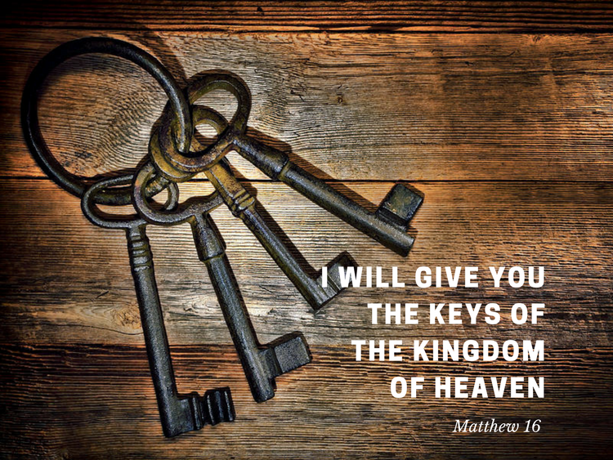


Shall we expose the culprit right up front so everyone
can follow the problem?
Judah!
… the tribe responsible for guarding the Sacred Oracles, removed the Covenant Calendar Keys to the Kingdom!

Slide 15


Calendar of
Part 1: Scriptural Facts
Foundational
Information on Judah

Slide 16

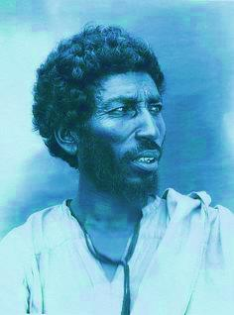
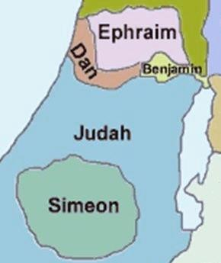
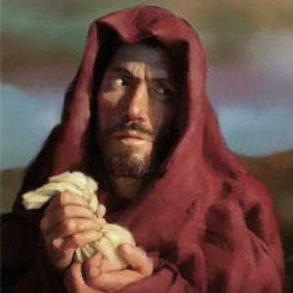
What About
Judah?
Brother?
Tribe?
Disciple?

Slide 17

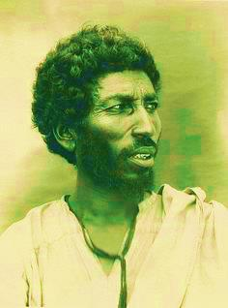
Judah, the Brother
Rather than kill Joseph, sell him for 20 shekels of silver
to the Midianites (Gen 37:26-28).
Married Shuah (a Canaanite), a daughter of a strange god
(Gen 38:2).
Judah committed adultery with Tamar, his daughter-in-law (Gen 38:16).
Judah promised Jacob to be surety for Simeon in Egypt’s prison, IF they could take Benjamin at Joseph’s request (basically Judah was surety for both Simeon and Benjamin). (Gen 43:1-10)
(Note Gen 42:35-38: About 8 years previous to Judah’s surety for Simeon and Benjamin, Reuben made the same request of Jacob which was denied.)
17

Slide 18
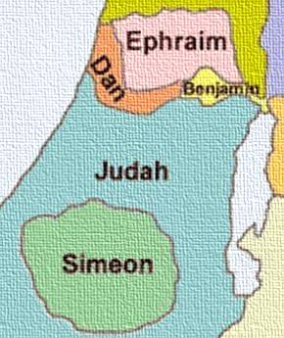
Judah, the Tribe (OT)
Remember, brother Judah was surety for both Simeon and
Benjamin to bring them back from Egypt (Gen 43:9-13).
Simeon (a smaller tribe) was given a land inheritance inside
the tribe of Judah. Eventually this tribe decreased in numbers
and was dispersed throughout Judah and the northern tribes.
Upon exile to Babylon, some may have been from the tribe of Simeon.
The tribe of Benjamin stayed with Judah when the kingdom split in two. (Was that because of Judah’s promise to Jacob of surety for Benjamin?)
Both Israel & Judah worshipped other gods. Israel was much worse being scattered by Assyria around 721 BC never to return.
Judah received the same prophetic warnings that were given to Israel about her apostasy … but for an additional 100 years.
Question: Did it do any good?
18

Slide 19
Calendar of
Part 2: From 701 - 699 BC
a. Sundial Introduction
b. Hezekiah’s 2 Signs

Slide 20
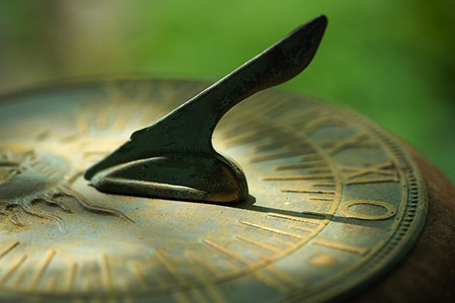
About 701 BC
Hezekiah’s Sundial Event
Sent by Yahuah to Correct ALL
Apostasy with the “moon goddess.”
An Old Testament Historical Turning Point
2 Kings 20:9-11
2 Chron 32:24
Isa 38:7-8
Notes:
Sept 19

Slide 21

Many of the Bible testimonies are recorded twice.
Hezekiah’s testimony (recorded 3 times) is given more attention for the sundial shadow moving backwards 10 degrees.

Slide 22
A Bible Hermeneutic worth repeating and remembering:
Yahuah does not repeat things
of no great consequence!
That means:
When something is given
attention an unusual
number of times –
it is time to take notice!

Slide 23

An Important Announcement
There were two signs given to King Hezekiah around 701 BC:
The sign for the approaching Jubilee year in Isaiah 37;
The sundial miracle in Isaiah 38.
One commentary says this: The extra fifteen years given to Hezekiah ended
with the deliverance of Jerusalem, marking the completion of the third year of
the ‘3rd-year’ sign …
The sundial miracle and other events around Hezekiah connect to:
The Jubilee Calendar used to calculate every 50 years of the 120 allotted Jubilees;
The Covenant Calendar used from month to month each year.
Hezekiah’s testimony is the only marker in the Old Testament and the only pivotal point that challenges the pagan “moon” calendar, AND, also establishes the exact year for the years 49, 50 and the new 1st year of the next Jubilee calendar.
Notes:
Sept 19 p 11

Slide 24

1st Sign Isa 37: Jubilee Calendar
Isa 37:30 And this shall be a sign unto thee,
Ye shall eat this year [49th yr] such as groweth of itself;
and the second year [50th yr] that which springeth of the same:
and in the third year [1st yr] sow ye, and reap, and plant vineyards,
and eat the fruit thereof.
Because the sundial miracle of Isaiah 38 is the same time frame of 701 BC, then:
a) this year [49th yr] = 701 BC
the second year [50th yr] = 700 BC (Some say this is about the 66th Jubilee.)
the third year [1st yr] = 699 BC
This information is part of a Jubilee Calendar study.
Today’s study is examining the history of “no-god” worship & apostasy among Yahuah’s people.
Notes:
Sept 19 p 11

Slide 25


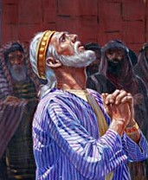
2nd Sign Isa 38: Yearly Calendar
Affects the Pagan Moonth Length
Isa 38:7-8 And this shall be a sign unto thee …
8 Behold, I will bring again the shadow of the degrees …
ten degrees backward …
2 Chron 32:24 In those days Hezekiah was sick to the death, and prayed unto Yahuah: … and he gave him a sign.
2 Kings 20:9-11 … shall the shadow go forth ten degrees,
or go back ten degrees?
10 And Hezekiah answered, It is a light thing for the
shadow to go down ten degrees: nay, but let the shadow return backward ten degrees.
11 And … he brought the shadow ten degrees backward …
Did Hezekiah make the right choice
for the sun to go backwards?

Slide 26

What if the shadow went forward?
Then what? If the shadow going backwards would lengthen the sun’s yearly circuit, then the shadow moving forward would shorten the sun’s yearly circuit.
Is it reasonable that the yearly circuit would have been shortened by 5¼ days, if the shadow moved forward 10 degrees?
360 – 5¼ = 354.75 solar days/yr.
Let’s do the math, considering the lunar cycle would have re-calculated to Judah’s 29½ days/mon.
12 mon x 29½ = 354 lunar days/yr.
Do you see the problem?
RESULT:
The lunar cycle/yr. would have been within 18 hrs. of the solar year length. It may have been impossible to understand the calendar needed to be restored without gazing at the moon!

Slide 27

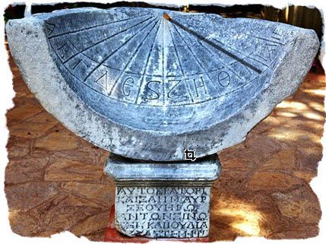
Sundial Shadow & Lunar Cycle Shift
We know the records of the flood account confirm there were 150
days within a 5 month period –
by means of 30 days/month.
The lunar cycle would have been a perfect 30 days from Yahuah’s perfect creation. A lunar cycle of 27.3 or 29½ days/month does not link with any of Yahuah’s numbering system.
Moon worship was well established among the pagans for a long time.
Jericho was destroyed because it was
a moon worshipping city.
Sundial Miracle did affect the Lunar Cycle by reducing the lunar cycle from 30 days to 27.3 or 29.5 days per cycle.
Yahuah altered the length of the lunar cycle at this time to separate the pagan month
(& worship practices)
from the beginning of
His festal months!

Slide 28


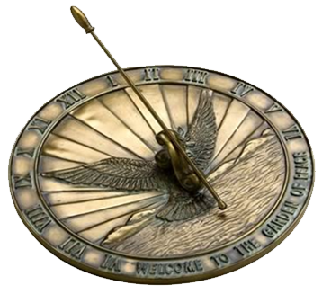
Calendar of
Part 3: Secular Historical Records
Velikovsky & Wong document the
calendar history of ancient civilizations.
Yahuah’s apostate people would
have had these same
challenges after 700 BC.

Slide 29


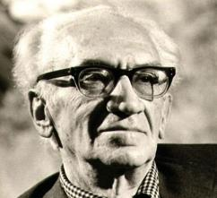
Historical Confirmation – Velikovsky (1950)
Shows at the time of the Exodus,
30 different cultures had the same calendar of 12 months with exactly 30 days/month for a total of 360 days/year.
These 30 world cultures were in an upheaval lasting about 50 years when the days of the month and year were in flux before settling down to a 365¼ day year and 29½ day lunar month.
Velikovsky claims the
historically recorded
time of the calendar
change period was
from 725-675 BC.
His theory is based on
a near collision with
a wandering planet
sized object which
caused the earth to
change its orbit slightly
around the sun, thus the change in the calendar days. This also affected the moon’s circuit.

Slide 30
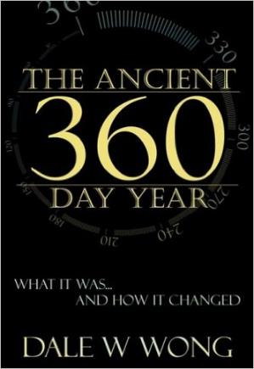
Historical Confirmation – Dale Wong (2006)
Published 2006
Calculated the year of Hezekiah’s sundial sign to be 713 BC.
He suggests that Yahuah actually moved the orbits of the earth and moon to accomplish this sign of moving the sundial shadow
10 degrees backward.
(This is an alternative to the catastrophe thesis of Velikovsky.)
However, both show the year change happened right around the same time,
plus or minus a few years.

Slide 31

Facts Where Velikovsky & Wong Agree
30 cultures around the world that used the 360 day year and 30 day month before 713 BC.
(Remember, the Exodus was around 1450 BC.)
Vedas of India had a 360 day year, and record the moon waxed for 15 days and waned for 15 days in a month.
-- Also: the sun moved north 180 days and moved south 180 days per year.
-- In a later period the Vedas record the year was reformed to 365.25 days/year.
Ancient Persia had a 360 day calendar; later it was reformed to add 5 Gatha [prayer] days to the year length.
Sumerians had the 360 day/year and 30 day month.
Babylonians adopted the Sumerian calendar.
-- At the beginning of the 7th century BC, Babylon added 5 days to the year.
Assyria: Clay tablets from the royal library in Nineveh showed a 360 day/year and 30 day/mon.
Ancient Egypt: The Canopus Decree and Ebers papyrus calendar had the same 360 year.
-- The year change occurred in the 8th or 7th century BC according to Plutarch and the Book of Sothis adding 5 epagomena days to the year. (These were celebrated birthdays for 5 gods.)

Slide 32

What are Epagomenal Days?
The Egyptian year was divided into twelve months of thirty days each, which means that each year was about five days short of the astronomical year.
To compensate for this difference, five extra days were added to the year, called epagomenal days [or birthdays of five gods]. Because they were not part of the normal year created by the gods, the Egyptian regarded these days as particularly ominous, and texts have survived listing exactly what may and may not be done during this period. Even the addition of these five days did not solve the concurrence problem with the solar year, however, which lasts 365¼ days.
As a result, the calendars shifted at a rate of 1 day every four years, and over time an important gap opened up between the real and the theoretical calendars.
This meant that the lunation no longer occurred in the inundation season, and the warm season no longer in the summer. The two calendars only coincided again once every 1,460 years. After an unsuccessful attempt to revise the calendar in the reign of Ptolemy III, this problem was eventually solved by the Romans by adding one leap day every four years to the Alexandrian calendar.
Source: http://www.globalegyptianmuseum.org/glossary.aspx?id=148
After an unsuccessful attempt to revise the calendar in the reign of Ptolemy III, this problem was eventually solved by the Romans by adding one leap day every four years to the Alexandrian calendar.
The Greek author Plutarch has recorded his own version of the creation of the epagomenal days. The sun god Helios (the Greek equivalent of Re) had put a curse on the goddess Rhea (the Egyptian sky goddess Nut), which meant that she was unable to bear children on any of the 360 days of the year. Hermes (the Egyptian god Thoth, the god of learning) solved the problem by adding five days to the year. Five children were born on these days, Osiris, Isis, Nephthys, and Seth, but also Apollo (= Horus), the latter because of the association between his original mother Hathor with the sky goddess Nut.

Slide 33
Facts Where Velikovsky & Wong Agree (con’t)
Rome had a 360 day year at the time of Romulus.
Mayans of Mexico – 360 days.
Incas of Peru in Central and South America had 360 days, and later added 5¼ days.
China added 5 days called Khe-ying days.
Polynesia – 360 days.
Many religions around the world based their beliefs on the number 360, seeing it as a sacred number by naming gods, idols, temples, etc. – one for each day of the year.
The 360 degree circle and 360 degree compass in use all over the world is a remnant of the year length prior to the change when the year length was exactly 360 days.
Velikovsky also writes:
“All over the world we find that there was at some time the same calendar of 360 days, and that at some later date, about the seventh century before the present era, five days were added at the end of the year, as “days over the year,” or “days of nothing.”
Scholars who investigated the calendars of the Incas of Peru and the Mayas of Yucatan wondered at the calendar of 360 days; so did the scholars who studied the calendars of the Egyptians, Persians, Hindus, Chaldeans, Assyrians, Hebrews, Chinese, Greeks, or Romans.” Worlds in Collision, p. 336.
The Mul-Apin tablets also prove
Egypt had a 360 day year.
Notes:
Velikovsky has a footnote on p 336 commenting on C F Dupuis, published in 1872 “The Origin of All Religious Worship” p 41, that … many religions based their worship on 360 for numbers of gods, idols, 360 genii; 360 temples built on the mountain of Lowham in China, and to the wall of 360 stadia “with which Semiramis surrounded the city” of Babylon. However, he goes on to note: “This material did not convey to its collector the idea that an astronomical year of 360 days had been the reason for the sacredness of the number 360.

Slide 34
Calendar of
Part 4: From 700 - 400 BC
History from
Hezekiah to Nehemiah
Keeping the events in order of date
is very important for this study.

Slide 35
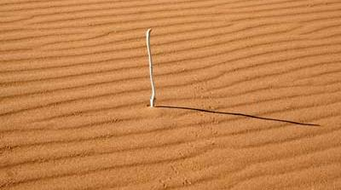
Hezekiah’s Sundial Shadow Went Back!
Secular historical evidence is very supportive of a world-wide calendar using only 360 days/year.
It took Ancient civilizations about 50 years to adapt their calendars to 365¼ days per year after the time of Hezekiah’s request for the sundial sign in approximately 700 BC.
Reasonable Assumption: One way for 5¼ days to be added to the 360 day/year calendar is for a giant heavenly body (such as an asteroid) to disrupt the sun’s movement. Magnetic pull could alter its usual orbit enough to enlarge the yearly circuit.
No days of the week would have been lost, just an additional number of days would be added to the 360 day circuit.
This event happened about 100 years before Judah’s captivity.

Slide 36
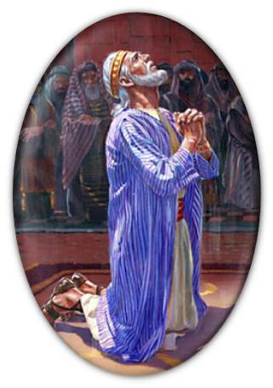
Hezekiah Used in a Mighty Way
Hezekiah was a very good king and cleaned up the land from paganism in a grand way.
Hezekiah’s reformation was annulled when his son Manasseh came to the throne for
55 years.
As wicked as King Manasseh was, he did repent before he died.
Unfortunately, the seeds of pagan worship (sun and moon gods) were again sown deep, lasting to the end of the Old Testament historical account – as will be shown.
Notes:
Sept 19th p 11

Slide 37
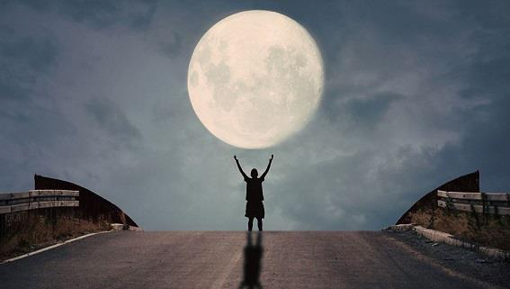
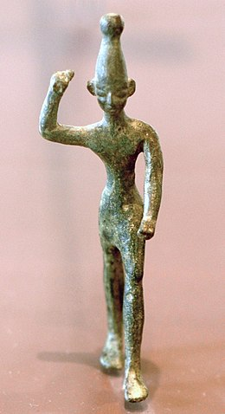
Where is Ugarit?
[Syria]
Ugarit, ancient city lying in a large artificial mound called Ras Shamra (Raʾs Shamrah), 6 miles (10 km) north of Latakia (Al-Lādhiqīyah) on the Mediterranean coast of northern Syria. Its ruins, about half a mile from the shore, were first uncovered by the plow of a peasant at Al-Bayḍā Bay.
“MOON”
Along with the sun and the planet Venus, the moon was worshiped as a cosmic god by many pagan nations of the ancient world.
The moon was known as Sin [Seen] in Babylon and Assyria; Nanna in Sumer, and Yarih at Ugarit [Syria]. This last name is closely related to the Hebrew word for moon. While the worship of the moon and any other natural phenomenon was strictly forbidden among the Hebrews (Deut 4:19; 17:3), the evil King Manasseh [~698 BC] established the cults of "all the host of heaven," presumably including the moon, in the court of Solomon's Temple (2 Kings 21:3-5).
(From Nelson's Illustrated Bible Dictionary)
Notes:
Sept 19 p 11

Slide 38

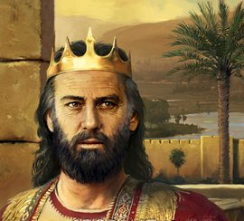

Did King Manasseh not pay attention to these words?
Psalm 81:8-13
approx. 1000 BC
Hear, O my people … if thou wilt hearken unto me;
There shall no strange god be in thee;
neither shalt thou worship any strange god.
But my people would not hearken to my voice …
So I gave them up unto their own hearts’ lust:
And they walked in their own counsels.
Oh that my people had hearkened unto me,
and Israel had walked in my ways.

Slide 39
698 – 629 BC Manasseh & Josiah
Ref. | Date | Description
2 Chr 33:3-6 Vs 15 Vs 21-25 | ~698 BC | King Manasseh built the high places, altars for Baalim and all the groves to worship all the host of heaven. He caused children to pass through the fire; used witch craft and dealt with familiar spirits & wizards; he set up carved idols in Yahuah’s house; (see 2 Kings 21:3). Manasseh repented and took away the strange gods, idols, altars & repaired Yah’s house. In 2 years King Amon brought back all the evil that Manasseh had finally done away with.
2 Kings 22:17 | ~640 BC | King Josiah alerts Yahuah’s people of the consequences for burning incense to other gods if there is no repentance.
2 Chr 34:3-7 | ~640 BC | King Josiah cleans up all the idols, groves, and images.
Zeph 1:4, 5 | ~630 BC | Yahuah will punish Judah for worshipping Baal [sun god] and all the host of heaven.
Jer 1:16 | ~629 BC | Jeremiah utters judgments against Judah for burning incense to other gods.
Jer 2:5, 8, 20 | ~629 BC | Judah has followed idols; prophesied by Baal [sun god]; played the harlot.
Next – there is a word from Zephaniah & Jeremiah.
Notes:
Sept 19 p 12

Slide 40
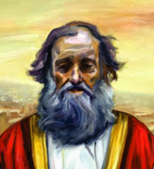
Zephaniah Warns Judah! 630 BC
Zephaniah 1 [630 BC]
I will also stretch out mine hand upon Judah, and upon all the
inhabitants of Jerusalem; and I will cut off the remnant of Baal
from this place, and the name of the Chemarims with the priests;
And them that worship the host of heaven upon the housetops; and them that worship and that swear by Yahuah, and that swear by Malcham;
And them that are turned back from Yahuah; and those that have not sought Him, nor inquired for Him.
And it shall come to pass in the day of Yahuah's sacrifice, that I will punish the princes, and the king's children, and all such as are clothed with strange apparel.
40

Slide 41
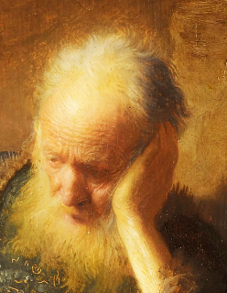
Jeremiah Warns Judah 629 BC
Jeremiah 2 [629 BC]
Thus saith Yahuah, What iniquity have your fathers
found in me, that they are gone far from me, and
have walked after vanity, and are become vain?
And I brought you into a plentiful country, to eat the fruit
thereof and the goodness thereof; but when ye entered,
ye defiled my land, and made mine heritage an abomination.
The priests said not, Where is Yahuah? and they that handle the law
knew me not: [lawgiver] the pastors also transgressed against me, and the prophets prophesied by Baal, and walked after things that do not profit.
Wherefore I will yet plead with you, saith Yahuah, and with your
children's children will I plead.
41

Slide 42

Judah’s Extra Warnings! (con’t)
Jeremiah 2 [629 BC]
Hath a nation changed their gods, which are yet no gods? but my
people have changed their glory for that which doth not profit.
For my people have committed two evils; they have forsaken me
the fountain of living waters, and hewed them out cisterns,
broken cisterns, that can hold no water.
Hast thou not procured this unto thyself, in that thou hast forsaken
Yahuah thy Elohim, when he led thee by the way?
Thine own wickedness shall correct thee, and thy backslidings shall reprove thee: know therefore and see that it is an evil thing and bitter, that thou hast forsaken Yahuah thy Elohim, and that my fear is not in thee …
For of old time I have broken thy yoke, and burst thy bands; and thou saidst,
I will not transgress; when upon every high hill and under every green tree
thou wanderest, playing the harlot.
42

Slide 43
625 BC Josiah Purges the Land
Ref. | Date | Description
2 Chr 33:3-6 | ~698 BC
2 Kings 22:17 | ~640 BC
2 Chr 34:3-7 | ~640 BC
Jer 1:16 | ~630 BC
Jer 2:5, 8, 20 | ~630 BC
Zeph 1:4, 5 | ~630 BC
2 Kings 23:5, 13 14, 24 | ~625 BC (15 years later) | King Josiah again cleans up all the idols, groves, and images that were worshipped to all the host of heaven. He also put away consulted mediums, household gods and idols and all the idolatrous priests that burned incense unto Baal, to the sun, and to the moon, and to the planets, and to all the host of heaven.
Next – there is another word from Jeremiah.
Notes:
Sept 19 p 12

Slide 44

Jer 6:16-17 counselled the people to
stay with the Old Paths
Thus saith Yahuah, Stand ye in the ways, and see, and ask for the old paths, where is the good way, and walk therein, and ye shall find rest for your souls. But they said, We will not walk therein.
17 Also I set watchmen over you, saying, Hearken to the sound of the trumpet. But they said, We will not hearken.
in approx. 612 BC.
There will be consequences when Babylon arrives!

Slide 45
610 – 600 BC False Shepherds in Judah
Ref. | Date | Description
Jer 10:2-5 Jer 12:16 | ~610 BC | Learn not the way of the heathen cutting & setting up a tree [Ashtoreth pole]; False shepherds taught Yahuah’s people to swear by Baal.
Jer 19:4, 5, 13 | ~605 BC | High places of Baal [sun god] built to pass their children through the fire to Molech.
Jer 7:9, 18, 31 Jer 8:1-5 | ~600 BC ~600 BC | Judah worships other gods, burns incense to Baal; makes cakes to the queen of heaven [the moon goddess]; build high places; burn their children in the fire. Jerusalem has loved to worship the sun, moon, all the host of heaven.
Jer 8:2 Vs 19 | ~600 BC | The bones of Judah’s leaders shall be spread before the sun and the moon and all the host of heaven, which they have loved and served; have walked after and sought; which they have worshipped. Jerusalem has provoked Yahuah to anger with her carved images and foreign idols.
Jer 9:14 | ~600 BC | Judah has walked according to the imagination of their own heart and followed the Baals [sun gods] as their fathers taught them.
Jer 11:10, 13,17; 16:11 | ~600 BC | Both the house of Israel and Judah have gone after other gods to serve them and worship them. (Question: Want to guess which gods they were serving?)
Jer 23:13, 27 | ~600 BC | Prophets in Samaria prophesied in Baal and caused Yahuah’s people to sin.
Babylon arrives 606 BC.
Apostasy has a severe increase as time marches on!
Notes:
Sept 19 p 12

Slide 46
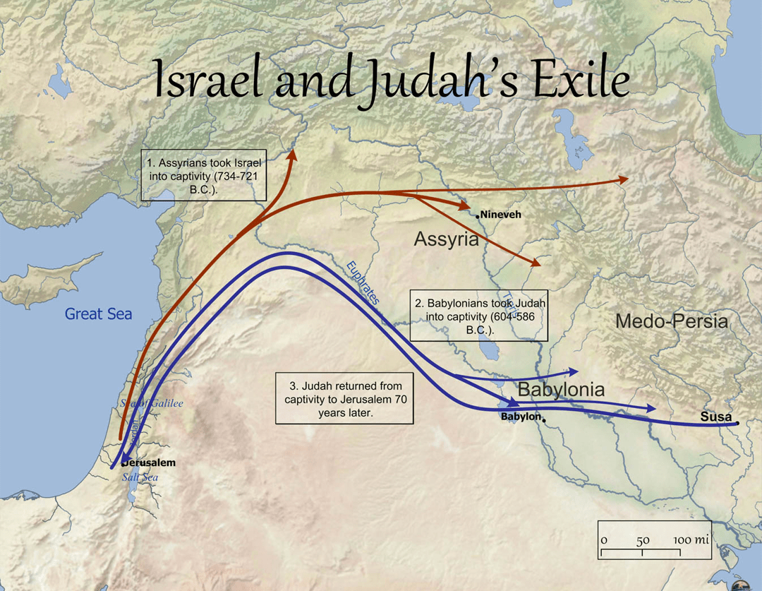
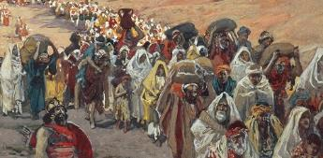
(Israel will not return to the land.)
Jer 13:27
(602 BC)
I have seen thine adulteries, and thy neighings, the lewdness of thy whoredom, and thine abominations on the hills in the fields. Woe unto thee, O Jerusalem! wilt thou not be made clean? when shall it once be?
Babylon Will Return!
46

Slide 47
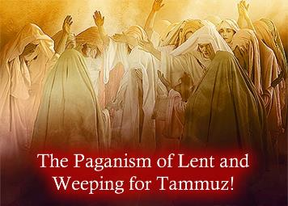
595 - 593 BC Judah Weeping for Tammuz
Ref. | Date | Description
Ezekiel | Review | Most of the book of Ezekiel is a warning to get rid of pagan worship. Ezekiel is exiled in 596 BC to Babylon [under the 2nd attack]; those left in Jerusalem are still worshipping pagan gods in pagan ways.
Eze 8:14 Eze 8:16 | ~595 BC | Women weeping for Tammuz [son of Nimrod, the sun god]. Priest’s backs are facing the temple, their faces toward the east, worshipping the sun!
Eze 20:26 | ~593 BC | Caused their firstborn to pass through the fire [sacrifices to Molech].
Ezekiel pleads for Judah around Babylon’s 2nd attack.
More than 800 years earlier Moses had warned Israel to not seek out other gods. Because they refused
to listen, things just got worse!
Notes:
Nov 7th

Slide 48
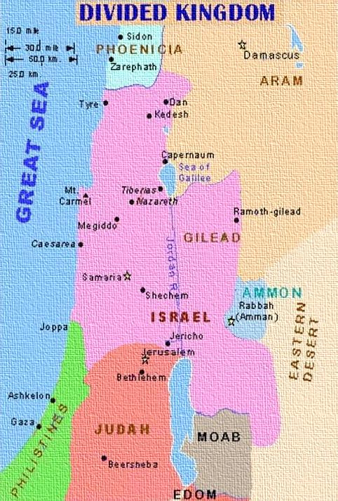

2 Daughters
from 1 Mother
Ezekiel 23 [593 BC]
Son of man, there were two women,
the daughters of one mother:
And they committed whoredoms in Egypt; they committed whoredoms in their youth …
48

Slide 49
Aholah & Aholibah
Ezekiel 23 [593 BC]
And the names of them were Aholah
the elder, and Aholibah her sister …
Thus were their names; Samaria is Aholah, and Jerusalem Aholibah.
Aholah - Samaria
[H168: her tent; as in an idolatrous
sanctuary, not set up by Yahuah].
Aholibah - Jerusalem
***[H168: my tent; as this sanctuary
was set up by Yahuah].
Aholah
Aholibah
49

Slide 50
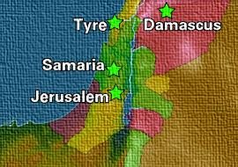
Aholah ~ Samaria
Ezekiel 23 [593 BC]
And Aholah played the harlot when
she was mine; and she doted on her lovers,
on the Assyrians her neighbours,
Thus she committed her whoredoms with them, with all them that were the chosen men of Assyria, and with all on whom she doted: with all their idols she defiled herself.
Neither left she her whoredoms brought from Egypt …
Wherefore I have delivered her into the hand of her lovers,
into the hand of the Assyrians, upon whom she doted.
50

Slide 51
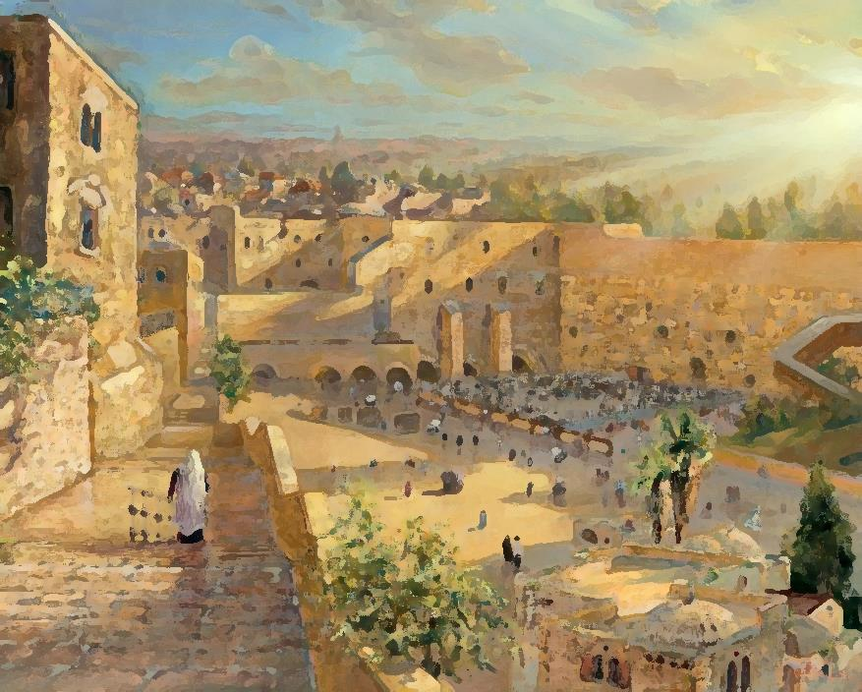
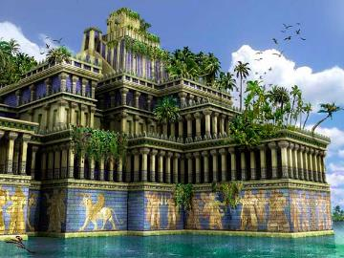
Aholibah ~ Jerusalem
Ezekiel 23 [593 BC]
And when her sister Aholibah saw this, she was
more corrupt in her whoredoms than her sister.
She doted upon the Assyrians her neighbours …
Then I saw that she was defiled …
And that she increased in her whoredoms …
… after the manner of the Babylonians of
Chaldea …
… she doted upon them, and sent messengers
unto them into Chaldea.
51

Slide 52
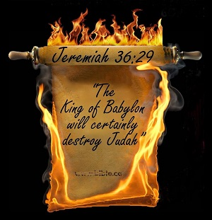
Aholibah ~ Jerusalem
Ezekiel 23 [593 BC]
And the Babylonians came to her …
and they defiled her with their whoredom,
and she was polluted with them …
Yet she multiplied her whoredoms, in calling
to remembrance the days of her youth, wherein
she had played the harlot in the land of Egypt.
There, O Aholibah, thus saith Yahuah; Behold, I will
raise up thy lovers against thee … I will bring them
against thee on every side [again];
The Babylonians, and all the Chaldeans, Pekod, and Shoa,
and Koa, and all the Assyrians with them …
And it was so!
52

Slide 53
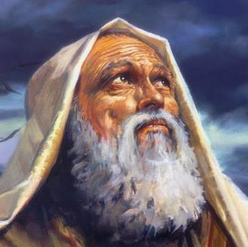
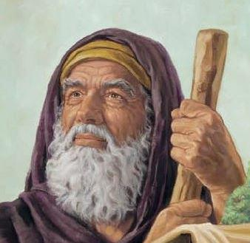


Will Judah Change?
Between Ezekiel 23
[in 593 BC] will the tribe of Judah change her ways by the time Malachi writes in 397 BC – about 200 years later?
53

Slide 54

Can a Leopard Change its Spots?
(Jer 13:23)

Slide 55
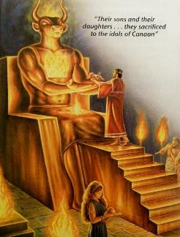
590 BC Pleas for Judah After 2nd Exile
Ref. | Date | Description
Jeremiah | Review | Jeremiah also confirms what was happening in Jerusalem after Babylon’s 1st attack in ~606 BC.
Jer 32:29-30,35 Jer 44:3-8 | ~590 BC | Both Israel & Judah built high places of Baal [sun god]; caused their sons and daughters to pass through the fire to Molech. Consequences?? … Babylon will burn Judah’s houses that have offered incense to Baal and poured out drink offerings to other gods, and have done only evil from their youth.
Lam 4:10 | ~590 BC | Judah has cooked her own children for their food.
Jeremiah verifies how deep Judah’s apostasy went, burning and eating their children, seeking the pagan feasts, honoring the
sun god and the moon goddess.
Notes:
Nov 7th

Slide 56
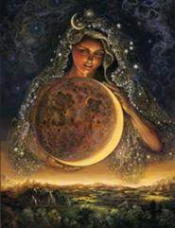
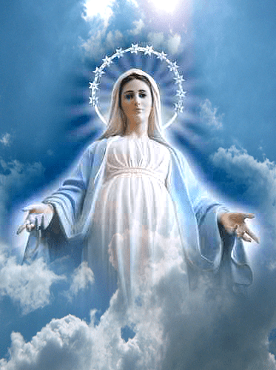
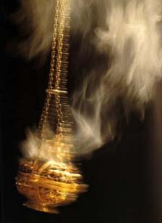

~585 BC Judah Under 3rd Attack
Ref. | Date | Description
 | Review | Babylon attacks Judah a 3rd time; their worship patterns do not change.
Jer 44:17-25 | ~585 BC | Judah has burned incense to the queen of heaven [moon goddess].
Both Isis & the Catholic Mary
claim this title.
What happens when Judah returns?
Will the queen of heaven become Judah’s new contaminated “shekinah glory”?
Notes:
Shekinah glory does link to Ashtoreth goddess worship. Hebrew word is “sekina” … something to take note of.

Slide 57

Judah: Before, During and After Babylon
Judah is carried off to Babylon about 100 years after the 360 day Creation Calendar needed to be adjusted.
Pagan Babylon had long worshipped (1) the sun (coming up and going down), and (2) the moon, as well as (3) other bodies in the heavens
(which Israel & Yahuah’s people today are commanded not to do).
Questions: (1) How reasonable is it to conclude that after Judah lodged in Babylon for 70 years, they came back to Jerusalem with many “traditions”? (1) Would these traditions replace the divine requirement for the month commencement of the festivals from Yahuah’s Covenant Calendar calculation in exchange for the moon/month calculation of the pagans?
Sighting the crescent moon happens near the setting of the sun.
This factor alone shows how easy it was for Judah to completely accept
and adapt to [1] “sunset” beginning the new day, and the [2] “crescent moon” beginning the new month. After all … this apostasy had been practiced for 800+ years since Joshua died.

Slide 58
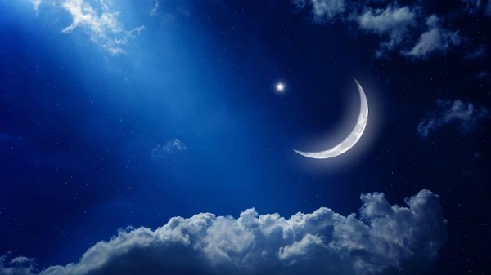
Historical Quote:
Roland de Vaux, Ancient Israel, Vol. 1, p. 191-192:
… compare the story of Josias’ reform (2 Kings 22-23 [in 641-642 BC]) with that of the capture of Jerusalem (2 Kings 25 [599 BC]). Possibly, too, this was the time when they [Judah] began to reckon the day from evening to evening, and the months from the appearance of the new moon at sunset. All this points to the adoption of the Babylonian calendar and is explained by the historical circumstance that under Joiaqim, son of Josias,
the kingdom of Judah became a vassal state of Nabuchodonosor.

Slide 59
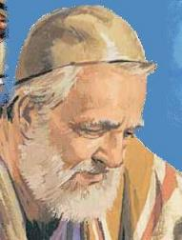
Ezra Pleads for Judah
Ezra 9-10 Summary [458-456 BC]
1 The princes told Ezra the people of Israel, priests, and Levites, did not separate themselves from the pagans, doing according to their abominations, even of the Canaanites, Hittites, Perizzites, Jebusites, Ammonites, Moabites, Egyptians, and the Amorites [8 pagan nations].
2 They have taken daughters of ‘no gods’ for themselves, mingling holy seed with paganism.
3 Ezra rent his garment, plucked the hair off his head and beard, in astonishment till the evening.
5-15 Ezra speaks a prayer of confession, repentance for the iniquities are increased over their head yet again! They need forgiveness!
7 Since the days of our
fathers have we been in a
great trespass unto this day;
and for all these iniquities Judah was delivered into the hand of the pagan nations.
8 Ezra is grateful Yahuah has extended mercy and grace allowing a remnant to escape and return to Jerusalem.
Ezra then asks Yahuah …
10 “What shall we say for we have
forsaken thy commandments when
You commanded us not to give our daughters unto pagan men, neither take pagan daughters for our sons?”
59

Slide 60

Ezra Pleads for Judah (con’t)
Ezra 9 Summary [80 years from captivity]
13 Ezra confesses the punishment for all the evil deeds, and great trespasses, was less than their iniquities deserve, yet Yahuah gave deliverance.
14 Ezra acknowledges if they should repeat this abomination with the pagan nations, Yahuah would have the right to be angry and consume them so that not a remnant could escape.
15 Ezra is thankful that Yahuah is righteous: for Judah has escaped. Now the people are standing before Yahuah in trespasses again, and
they will not escape again.
Ezra 10 Summary
1 Now when Ezra had
prayed, confessed and
wept, he cast himself
down before Yahuah before a very great congregation of weeping men, women and children.
2 The people agreed they have trespassed against Yahuah by
taking strange wives.
3 A covenant was made by the people with Yahuah on that day, to put away all their strange wives. [For how long?]
60

Slide 61
Only 80 years have passed & the spots are still the same! (Jer 13:23)

Slide 62
~457 BC Judah’s 2nd Return
Ref. | Date | Description
 | Review | 2nd & 3rd Return of the Exiles from Babylon
Ezra 9:1-2 2nd Return | ~457 BC | Levites & priests had taken pagan wives of these nations: Canaanites, Hittites, Perizzites, Jebusites, Ammonites, Moabites, Egyptians & Amorites. They also took pagan women for their sons. The princes and rulers were chief in this trespass.
Ezra did everything he could to encourage the people to repent and change their ways.
(1) Did the people honour that promise?
(2) For how long?
Notes:
Sept 19 p 12

Slide 63
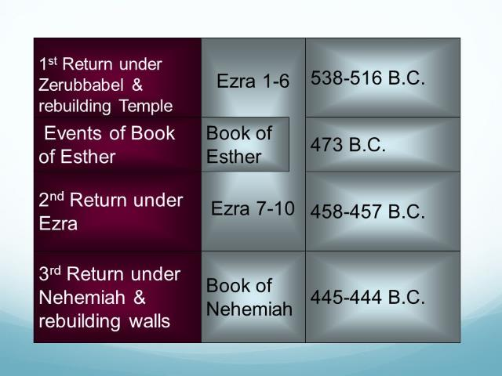

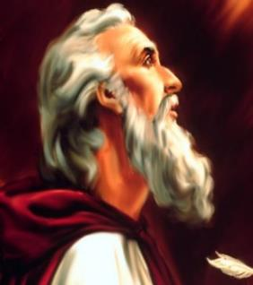

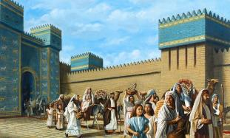

Judah After the Exile
After 70 years of exile, did Judah change her ways with Ezra [458 BC] (80 yrs later) &/or Nehemiah [445 BC] (93 yrs later)?
63

Slide 64

Secular Historical Quotes
Secular historical quotes are important! However, not one quote should be used because it suits what we want to hear!
Many quotes can be found in historical records in libraries
or on the internet to support any kind of calculation for any festival calendar.
That does not mean
these quotes are
divinely inspired or
can be fully trusted.
We acknowledge these quotes only when they align with the history
of Israel & Judah in the Old Testament along with the Covenant Calendar in Torah.

Slide 65
Ancient Calendar History
"In Israel, the day was for a long time reckoned from morning to morning ... and
it was in fact in the morning, with the creation of light,
that the world began; the distinction of day and night, and time too, began on a morning (Gen. 1:3-5, cf. 14:16,18)... The change of reckoning must therefore have taken place between the end of the monarchy
and the age of Nehemias ... this would bring us to the beginning of the exile ..." (Ancient Israel, p. 181-182).
"A new stage in the investigation of the problem of the calendar of ancient Israel was marked by the appearance of a learned article by E. Koenig in 1906 ... He maintains that two distinct calendars were current in ancient Israel. The first, a solar calendar ... This solar calendar was well adapted to the conditions of the simple, agricultural life which the Israelites lived during the first period of their sojourn in Palestine. It reckoned the day from sunrise [Dawn] ... (Supplementary Studies in The Calendars of Ancient Israel, p. 1-148.)
(con’t) “The second calendar was a luni-solar year ... The day now came quite naturally to be reckoned from sunset ... This second calendar was obviously based upon Babylonian models and was adopted under direct Babylonian influence at about 600 B.C., when Babylonian religion and general culture began to affect with steadily increasing force the Jewish exiles in Babylonia and, through those of them who return from exile, the Jews who had remained in Palestine.”
65

Slide 66




Babylonian & Jewish Calendar History
"So far as we know, the Babylonian calendar was at all periods truly lunar ... the month began with the evening when the new crescent was for the first time again visible shortly after sunset. Consequently, the Babylonian day also begins in the evening ..." (Exact Sciences in Antiquity, p. 106).
"When the Jews returned to Palestine after their Babylonian exile (516 B.C.E.) they brought back with them the Babylonian astronomy and way of reckoning time ..." (What is a Jew, p. 108).
"... the Israelites, like the Babylonians, counted their days from sunset to sunset ...” (NIV Study Bible, p. 707).
… the Mishnah (the collection of Jewish law [not Torah!] made at the end of the 2nd century AD) fully describes the system which the Jews had worked out under Babylonian influence ..." (Eerdman's Handbook to the Bible).

Slide 67

Babylonian & Jewish Calendar History
"Days were reckoned from morning to morning ... Following the reign of King Josiah (c. 640-609), and especially after the Babylonian exile a number of significant and enduring changes occurred in the Israelite calendar showing that the Jews gradually adopted the Babylonian calendar of the time ... the seven day week persisted despite its failure to divide evenly either the month or the year. The day however, was counted from evening to evening, after the Babylonian fashion ..." (New Catholic Encyclopedia -Volume 11, p. 1068).
"Among the ancient Israelites, as among the Greeks, the day was reckoned from sunset to sunset. This was the custom also of the Gauls and ancient Germans, and was probably connected originally with the cult of the moon. There is, however, evidence that this was not the custom at all times ..." (Delitzsch in Dillmann's Commentary on Gen. i. 5).

Slide 68

Nehemiah Warns Judah 445 BC
Nehemiah 13 Summary [93 years since Babylon captivity]
15 Nehemiah witnessed Judah treading the winepresses,
and selling all kinds of produce on Sabbath. Merchants
were also selling their wares in Jerusalem on Sabbath.
17 Nehemiah confronted the leaders of Judah, "Why are you
profaning the Sabbath in this evil way?” This was exactly
what their ancestors had done, sending Judah into exile.
19 Nehemiah commanded from then on the gates of the city should be shut as darkness fell every Friday evening, not to be opened until the Sabbath ended to prevent further abomination with the pagan nations.
68

Slide 69

Nehemiah Warns Judah (con’t)
Nehemiah 13 [93 years since Babylon captivity]
20 The merchants would be arrested if they came near the city wall.
23 Nehemiah also noted that some of the men of Judah had married women from Ashdod, Ammon, and Moab. He made them swear they would not let their children intermarry with the pagan people of the land, saying …
26 “That’s exactly how Solomon got into so much trouble!”
29 Nehemiah prays for forgiveness of the leaders defiling
the priesthood and the promises and vows that were broken.
30 Next he purged out everything foreign to set things
in order for obedience to the worship statutes and
separation from pagan nations.
The patterns always repeat!
69

Slide 70
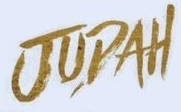
Did change her spots yet?
Hardly!

Slide 71
~435 – 397 BC Judah’s 3rd Return
Ref. | Date | Description
 | Review | 2nd & 3rd Return of the Exiles from Babylon
Ezra 9:1-2 2nd Return | ~457 BC
Neh 13:23 3rd Return | ~435 BC | Jews had married wives of Ashdod, Ammon and Moab – defiling the priesthood. Children could no longer speak the Hebrew language.
Mal 2:3 | ~397 BC | Yahuah will take away the dung of Judah’s solemn feasts; these are pagan feasts.
The very last record verifies how deep the former apostasy went.
Judah was taken captive due to
not honoring Yahuah’s worship statutes.
Once the exiles returned, it was less than 140 years
for them to once again be honoring the pagan feasts.
Notes:
Sept 19 p 12

Slide 72

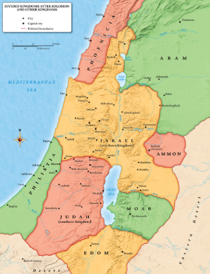

Final Words from Malachi to Judah
Malachi 2 [397 BC]
1 And now, O ye priests, this commandment is for you.
2 If ye will not hear, and if ye will not lay it to heart,
to give glory unto my name, saith Yahuah of hosts,
I will even send a curse upon you, and I will curse your blessings …
8 But ye are departed out of the way; (*H1870)
ye have caused many to stumble at the law …
*Keep this
in mind to compare to definition of “lawgiver” (H2710).
*Way – H1870; Derek – a serious search reveals that this word pertains to the *yearly cycles of Yahuah’s Worship Mo-edim. Malachi tells us that Judah has rejected the Mo-edim of Yahuah and has sought after their own understanding!

Slide 73

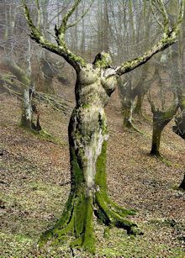
of Judah!
Malachi 2 [140 years since Babylon captivity]
9 Therefore have I also made you contemptible
and base before all the people, according as
ye have not kept my ways, but have been partial in the law.
11 Judah hath dealt treacherously, and an abomination
is committed in Israel and in Jerusalem; for Judah
hath profaned the holiness of Yahuah which he loved,
and hath married the daughter[s] of a strange god.
In:
397 BC
Judah rejected Yahuah’s Covenant Way of life! What direction did Judah take? The Lunar calendar of the 2nd Temple era? This is fully documented!
Notes:
Sent from Tim on Mal 2: Saturday, September 22, 2018 9:33:07 PM
Shalom Deborah. I would like to follow up on my last message.
I believe from extensive research that it was Yahudah that facilitated removing the tequfah and inserted the moon based calendar. I am not alone on this.
Yahudah deceived the people, and we see that revealed in the verses where Yahusha was speaking to the Pharisees in Matthew 23 which I sent earlier.
Yahudah butchered our Mashiach.
The second temple era, when the Yahudim were in control, is when the lunar based calendar system is fully documented by the Zadokite priests of Qumran, as being instilled in the Temple proceedings.
Secular history also agrees with this. Not that secular history has any authority, but only that it is more proof of the Scriptures.
Now lets read Malachi 2. Context is Yahudah.
Mal 2:8 “But you, you have turned from the Way, [Qodesh Set-Apart Appointed Times] you have caused many to stumble in the Torah. You have corrupted the covenant of Lĕwi,” said יהוה of hosts.
And teachers want me to believe that Yahusha worshipped in accordance with the very ones who rejected Yahuah's Mo-edim? Really? This suggestion leaves me nearly speechless!
Mal 2:9 “And I also, I shall make you despised and low before all the people, because you are not guarding My ways, and are showing partiality in the Torah.”
Mal 2:10 Have we not all one Father? Did not one Ěl create us? Why do we act treacherously against one another, to profane the covenant of the fathers?
Mal 2:11 Yehuḏah has acted treacherously, and an abomination has been done in Yisra’ĕl and in Yerushalayim, for Yehuḏah has profaned what is set-apart to יהוה – which He had loved – and has married the daughter of a foreign mighty one. [ Moon god!]
So what I am trying to expose is - why is ANYONE looking to the so called "Hebrew Calendar" of the Jews today? The lunar based calendar which is promoted by Judaism and promoted by Lighted Way Ministries is a contamination of Yahudah!
Why would anyone look to the lunar based calendar and it's filthy messages concerning the life of Yahusha?
Honestly, I simply cannot believe what I saw on that video clip. I am totally appalled at the outright blatant convoluted contamination that was expressed by ones whom I used to respect ad learned teachers.
I am not saying they do not have some good materials for most certainly they do indeed have some great messages! It is just that their messages about timing of Yahuah's Feasts and the life of Yahusha is contaminated by the Pharisee's evil abominations of moon worship.
Just my thoughts for what it is worth.
May Yahuah bless you always.
Timothy Astleford

Slide 74
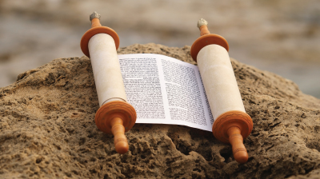
Judah, the Tribe (OT)
Judah had many troubles before and after Babylon, violating many Torah Truths. What are the answers to the following questions with regards to Covenant Calendar? How did Judah …
depart out of the way?
cause many to stumble at the law?
deal treacherously?
become an abomination?
profane the holiness of Yahuah?
marry the daughter[s] of a strange god?
What did Judah bring back from Babylon
as far as “Calendar” is concerned?
Answer: The Babylonian Calendar?!
In the Tanach Judah gave prominence to the moon over the Blood-ratified Covenant Calendar. Would that be classed as worship?
Matt 23:15 has some answers.
74

Slide 75
Words from King David?
Psalm 106:34-39
approx. 1000 BC
They were mingled among the
heathen, and learned their works.
And they served their idols: which
were a snare unto them.
Yea, they sacrificed their sons and
their daughters unto devils,
And shed innocent blood, even the
blood of their sons and of their
daughters, whom they sacrificed unto
the idols of Canaan: and the land was
polluted with blood.
Thus were they defiled with their own works, and went a whoring with their own inventions.
Therefore was the wrath of Yahuah kindled against his people, insomuch that he abhorred his own inheritance.
And he gave them into the hand of the heathen; and they that hated them ruled over them.

Slide 76
Upon return to Jerusalem Judah’s leaders placed
a curse on the Daniel 9 timelines that point to
the arrival of the Messiah.
Does their own declaration of a curse,
by default, cause them
to facilitate the removal
of the calendar keys?

Slide 77

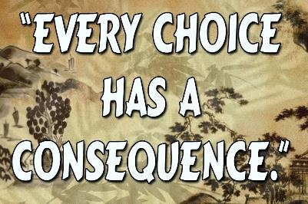

Some Thoughts to Ponder
Consequences
by Default?!
Many poor choices by the leaders
(in the Tanach)
tampered with or removed many of Yahuah’s Keys to the Kingdom!
77

Slide 78

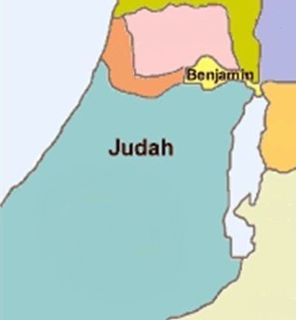
Everything points to:
Who tampered with the Covenant Calendar Keys?
… in the Old
Testament!

Slide 79
Calendar of
Part 5: New Testament Era
a. Judah the Tribe
b. Judas the Betrayer

Slide 80

Judah, the Tribe (New Testament)
The Sundial Miracle of 700 BC should have been a sign
to apostate Judah to return to the Old Paths {The Way}
of the Covenant Calendar.
The pagan moon-month contains less days than Yahuah’s festal month compromising all festival worship statutes.
Many prophets continually beckoned Judah to forsake the homage of Baal, Ashtoreth, pagan festivals and calendars.
If Judah would have restored the Covenant Calendar, is there a chance the people would have been given the knowledge of how to count out
the Daniel 9 timelines to recognize the Messiah?
Question:
80

Slide 81
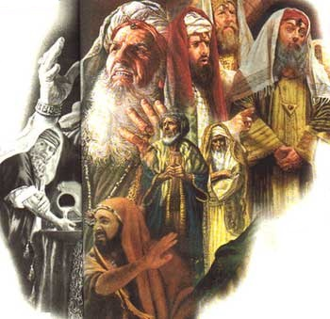
Scribes, Pharisees, Hypocrites!
These leaders of Judah did not stay true to the written instructions of Yahuah – especially for His Covenant Calendar. They erroneously professed authority to calculate the timing
for the festival worship statutes.
Judah’s leaders used instructions from the Mishnah
(the oral law in Judaism), as opposed to the written Torah,
or the Mosaic Law. The Mishnah also laid a multitude of burdens on the people (Matt 23:4).
The Mishnah was collected and committed to writing about
200 AD and forms part of the Talmud.
At the end of Yahusha’s ministry, He exposed the atrocious intentions of these leaders to the people while staying true
to His Covenant Calendar through His actions, miracles and parables.
81

Slide 82

The Matt 23 teaching was given on Monday Abib 12. It was the last time that Yahusha addressed the crowds in Jerusalem before the cross.
This was the most important day of teaching since He rode into Jerusalem for the Triumphal Entry on Abib 10th.
Luke 21:37 … in the day time he was teaching in the temple; and at night
he went out [of the city] …
A Word to the Multitudes

Slide 83

Matt 23:13 Shutting up the Kingdom
In Matt 23, Yahusha speaks to the multitudes in the hearing of
the scribes and Pharisees.
In verse 13 He begins to address the leaders with many “woes.”
  But woe unto you, scribes and Pharisees, hypocrites! for ye
  shut up the kingdom of heaven against men: for ye neither go in yourselves, neither suffer ye
  them that are entering to go in.
83

Slide 84


Removing the Key of Knowledge
These leaders, who should be unlocking the meaning of Yahuah’s Word, are instead taking away the opportunity for people
to know and understand it.
Luke 11:52 Woe unto you, lawyers! for ye have
taken away the key of knowledge: ye entered not in
yourselves, and them that were entering in ye hindered.
“A key is made to open a lock or door. By their false
interpretation of the Old Testament they had taken away the true
key or method of understanding it. They had hindered the people
from understanding it aright... If there is any sin of special magnitude,
it is that of keeping the people in ignorance.” (Barnes' Notes)
What is the “key” for understanding the truth of Yahuah’s Calendar?
84

Slide 85

The Night of Abib 12th
Disciple Judas (Greek for Judah), decided to carry out his plan with the chief priests and Pharisees.
Judas!

Slide 86



Judas, the Betrayer
Judas [Judah] Iscariot was the only disciple from Judea (Qeriyoth).
  (Kerioth: A town in the south of Judea (Josh 15:25) about 10 miles south of
  Hebron. Judas was probably a native of this place, hence his name Iscariot.)
  The original 11 disciples were from Galilee.
  The people living in the land of Galilee spoke (lived) out Yahuah’s Word in truth!
  That is why the Galileans were hated and despised by Judah!
Judas was “chosen” by Yahusha, knowing he had a devil.
  John 6:70-71 Yahusha answered them, Have not I chosen you twelve,
  and one of you is a devil? 71 He spake of Judas Iscariot the son of Simon:
  for he it was that should betray him, being one of the twelve.
Judas was a thief:
  John 12:6 This he [Judas] said, not that he cared for the poor; but
  because he was a thief, and had the bag, and bare what was put therein.
Judas gave surety to the Priests that he would deliver Yahusha:
  Luke 22:4 And he went his way, and communed with the chief priests
  and captains, how he might betray him [Yahusha] unto them.
  Judah likely followed Yahusha expecting to derive earthly advantage from the establishment
  of His Kingdom. MOST JEWS were SEEKING a MESSIAH as their PHYSICAL KING.
86
Notes:
Judas (EGW!) While Jesus was preparing the disciples for their ordination, one who had not been summoned urged his presence among them. It was Judas Iscariot, a man who professed to be a follower of Christ. . . . Judas believed Jesus to be the Messiah; and by joining the apostles, he hoped to secure a high position in the new kingdom. . . . {CC 285.2}
The disciples were anxious that Judas should become one of their number. He was of commanding appearance, a man of keen discernment and executive ability, and they commended him to Jesus as one who would greatly assist Him in His work. . .
-- While Jesus was preparing the disciples for their ordination, one who had not been summoned urged his presence among them. It was Judas Iscariot, a man who professed to be a follower of Christ. He now came forward, soliciting a place in this inner circle of disciples. With great earnestness and apparent sincerity he declared, "Master, I will follow Thee whithersoever Thou goest." Jesus neither repulsed nor welcomed him, but uttered only the mournful words: "The foxes have holes, and the birds of the air have nests; but the Son of man
294
hath not where to lay His head." Matthew 8:19, 20. Judas believed Jesus to be the Messiah; and by joining the apostles, he hoped to secure a high position in the new kingdom. This hope Jesus designed to cut off by the statement of His poverty. {DA 293.2}
The disciples were anxious that Judas should become one of their number. He was of commanding appearance, a man of keen discernment and executive ability, and they commended him to Jesus as one who would greatly assist Him in His work. They were surprised that Jesus received him so coolly. {DA 294.1}

Slide 87




Judah, the Betrayer
Judas betrayed Yahusha for 30 pieces of silver
severing himself from Yahusha:
  Matt 26:15 And they covenanted with him for thirty pieces of silver.
Both Judas and the tribe of Judah (Judea) clamoured
for Yahusha’s crucifixion shedding innocent blood:
  Mark 14:64 And they all condemned him to be guilty of death.
  Matt 27:25 … all the people said, His blood be on us, and our children.
Judas can be portrayed as a personification of the
Jewish people with no intent to follow Torah’s calendar.
Both had a lust for money and were influenced by Satan.
  Matt 23:28 (outward righteous appearance; but full of hypocrisy and iniquity).
Is there a pattern between Judas & Judah that needs to be acknowledged?
87
Notes:
Judas (EGW!) While Jesus was preparing the disciples for their ordination, one who had not been summoned urged his presence among them. It was Judas Iscariot, a man who professed to be a follower of Christ. . . . Judas believed Jesus to be the Messiah; and by joining the apostles, he hoped to secure a high position in the new kingdom. . . . {CC 285.2}
The disciples were anxious that Judas should become one of their number. He was of commanding appearance, a man of keen discernment and executive ability, and they commended him to Jesus as one who would greatly assist Him in His work. . .
-- While Jesus was preparing the disciples for their ordination, one who had not been summoned urged his presence among them. It was Judas Iscariot, a man who professed to be a follower of Christ. He now came forward, soliciting a place in this inner circle of disciples. With great earnestness and apparent sincerity he declared, "Master, I will follow Thee whithersoever Thou goest." Jesus neither repulsed nor welcomed him, but uttered only the mournful words: "The foxes have holes, and the birds of the air have nests; but the Son of man
294
hath not where to lay His head." Matthew 8:19, 20. Judas believed Jesus to be the Messiah; and by joining the apostles, he hoped to secure a high position in the new kingdom. This hope Jesus designed to cut off by the statement of His poverty. {DA 293.2}
The disciples were anxious that Judas should become one of their number. He was of commanding appearance, a man of keen discernment and executive ability, and they commended him to Jesus as one who would greatly assist Him in His work. They were surprised that Jesus received him so coolly. {DA 294.1}

Slide 88
Revelation’s Prophetic Insight
(Considering Jews of the New Testament, or of the land.)
Counsel to Smyrna
Revelation 2:9
Counsel to Philadelphia
Revelation 3:9
Judah has been very
unfaithful a long time.
Rev 2:9 I know thy works, and tribulation, and poverty, (but thou art rich) and I know the blasphemy of them which say they are Jews, and are not, but are the synagogue of Satan.
Rev 3:9 Behold, I will make them of the synagogue of Satan, which say they are Jews, and are not, but do lie; behold, I will make them to come and worship before thy feet, and to know that I have loved thee.
IF John is referring to the NT Jews then we must ask: “With the information we now have, is it still a
highly recommended suggestion to
‘go and ask a rabbi’ for the knowledge of Yahuah’s Ways?
Will any of the Jews ever change their ways?

Slide 89

One Other Group who are not Jews!
The Khazars are another whole imposter group of false Jews, NOT of Semitic origin.
They chose to convert to Judaism for their own political survival under much conflict and pressure to conform to Catholicism or Islamic teachings.
Over all the generations these people themselves have come to believe they were the original Jews.
Result: they follow all the Jewish traditions passed down to them, not learning the true Covenant Ways.
In Rev 2:9 and 3:9 John could also be referring to the Khazarians who are NOT Jews!
Khazars live in a large region covering some of Ukraine/Russia and Poland of today.
Around 740 AD, the Khazarian leaders SIMPLY INDOCTRINATED THEIR PEOPLE with the traditions and beliefs JUDAISM had been practicing for a long time. They are not true Jews of Judah’s tribe!
Note: Khazarians are not to be confused with the Ashkenazi people.
Notes:
Ashkenazi jews come from the line of Japheth, noah’s son that immigrated NORTH.

Slide 90


Can Judah ever change her ways?

Slide 91

Calendar of
Part 6: Geographical Investigation
Galilee in Comparison
to Naphtali & Zebulun
What does Galilee, Naphtali & Zebulun have
to do with Judah & Covenant Calendar?

Slide 92


Geography Clues (OT)
#1
#2
Sea of Galilee in the north is fed
by the Jordan River that continues south to the Dead Sea bordering
the Tribe of Judah on the east side.
Note for Map #1:
There are 12 divisions of land between 11 tribes.
Tribe of Levi did not have an allotment of land.
Joseph’s land inheritance was divided between Manasseh
and Ephraim. (Find Hebron.)
Note the location of Naphtali & Zebulun in the region of the
Sea of Galilee.
Note for Map #2:
The 12 tribes are divided into two main divisions – Israel & Judah.
At least 60-75 miles (100-120 km) from Jerusalem to Nazareth.
92

Slide 93

Geography Clues (NT)
#1
#3
Note for Map #1:
Note the location of Naphtali & Zebulun in the region of the Sea of Galilee.
Note for Map #3:
During Yahusha’s lifetime, there are
3 main provinces
in Palestine.
  Judea
  Samaria
  Galilee
The region of Galilee encompasses Naphtali, Zebulun, Issachar, and Asher.
Question: Is the Galilee geography correct and why does it matter?
93

Slide 94


Who? is from Where? … and Why?
Sea of Galilee is also known as Sea of Tiberias,
Lake of Gennesaret
and Sea of Chinneroth.
Unlike the Dead Sea it was a primary source of water.
Yahusha is from Nazareth, about 25 miles from
the Sea of Galilee. Nathanael asked [John 1:46],
“can anything good thing come out of Nazareth?”
  (This was in reference to the Judean mindset, as the Galileans
  adhered to the Torah in opposition to Judah’s evil ways.
  The comment was not so much aimed at the town of Nazareth.)
Yahusha’s 11 disciples resided in Galilee & spoke Galilean (Mark 14:70).
Only Judas the betrayer is from Judea (Qeriyoth/Kerioth – about 40 miles south of Jerusalem). Why is this significant?
Most of Yahusha’s ministry and miracles were in the province of Galilee. Why not Judea?
94

Slide 95
Why & How is Galilee so Special?
Matt 23:13 & Luke 11:52 are clear that Judah is the tribe that took away the keys of knowledge and shut
up the kingdom of heaven from the people.
There was darkness in Judea just as much after
the exile as before they went to Babylon.
Nathanael in John 1:46 asks the question:
Can any good thing come out of Nazareth?
Next Question: Where is Nazareth but in Galilee?
This is where Yahusha spent most of His ministry.
He had to pass through Samaria to attend the
3 appointed festivals in Jerusalem (Luke 17:11).
Why did Yahusha stay up in Galilee for most of His ministry
if it wasn’t because the Jews sought to kill him (John 7:1)?
Galilee was the home of Yahusha for all his life.
The first 3 gospels are chiefly taken up with
Yahusha’s public ministry in this province.
The entire area of Galilee is encircled with a
halo of sacred associations connected with the life,
works and teachings of Yahusha.
75% of Yahusha’s miracles were witnessed in Galilee.
Yahusha blesses
the land of Galilee.
95

Slide 96




Does Judah Have Special Regard?
Some say Judah is special because of these verses:
What does this mean …
Judah is ‘my’ lawgiver?
Is Judah supposed to teach and give Yahuah’s laws to the people?
Is Judah allowed to press her own set of laws upon the people?
What have most people been
taught about Judah’s authority?
(Also see Psalms 108:8.)
Usual Answer:
Judah is the lawgiver!
96

Slide 97

Would Malachi endorse
Judah as “the” Lawgiver?
The word "abomination“ in Hebrew is defined as something extremely offensive (like idolatry) causing separation from Yahuah. Idolatry was the central disregard of Yahuah involving literal and spiritual adultery. This was expressly prohibited in Deut 7:3, and a violation of His most sacred laws - the underlying cause of apostate worship. This led to unlawful marriages to daughters of strange gods that did not give up their idolatry.
Barnes’ notes: “Hence, the Jews say, ‘He that marrieth a
pagan woman is, as if he made himself son-in-law to an idol.’ ”
What about being in relationship with the calendar
of pagan gods? … Is this any different? …
Did Judah forfeit her authority long ago?
Does Judah condemn herself?
Mal 2:11
Judah hath dealt treacherously, and an abomination is committed in Israel and in Jerusalem; for Judah hath profaned the holiness of Yahuah which he loved, and
hath married the daughter[s]
of a strange god.
How would Judah qualify as Lawgiver?
97

Slide 98


Defining: Lawgiver!
*LAWGIVER H2710; chaqaq (khaw-kak'); a primitive root; properly, to hack,
i.e. engrave (Judg 5:14, to be a scribe simply); by implication, to enact (laws being cut in stone or metal tablets in primitive times) or (gen.) prescribe: -appoint, decree, governor, grave, lawgiver, note, portray, print, set.
Yahusha was the first “Lawgiver,” “law dispenser” and the
first to engrave His laws on stone. H2710 connects to H1870 – “the way,” the *yearly cycles of Yahuah’s Worship Mo-edim.
The word for lawgiver can also mean to be a scribe, to decree, to appoint, to describe, to prescribe, or print ACCURATELY (laws already made). The copying of Yahuah’s Laws were to be done with a high degree of accuracy.
Only Judah was delegated to DELINEATE Yahuah’s Torah.
Isaiah 33:22
For YAHUAH is our judge, YAHUAH is our lawgiver, YAHUAH is
our king; he will save us.
Yahuah, the Original Lawgiver!
Some information around Galilee will help to solve this puzzle about Judah.
98

Slide 99



Another Definition for Lawgiver!
What is Barnes’ meaning of Gen 49:10 & Ps 60:2 that Judah is my lawgiver?
(Barnes' Notes for Gen 49)
“Lawgiver is to be understood as judge, dispenser or administrator of law. Judah had the forerank among the tribes in the wilderness, and never altogether lost it. Nahshon the son of Amminadab, the prince of his tribe, was the ancestor of David, who was anointed as the rightful sovereign of all Israel, and in whom the throne became hereditary.
Consider: Judah was NEVER to be
the creator or adjuster of the law! Judah has created her own laws placing herself in the position
of a god usurping Another’s authority. Satan is the father of this action.
99

Slide 100
An Important Key in Galilee
Luke 2:4 And Joseph also went up from Galilee,
out of the city of Nazareth, into Judaea,
unto the city of David …
Matt 2:22 But when he [Joseph] heard that Archelaus did reign in Judaea … he turned aside
into the parts of Galilee.
Luke 2:39 … they [Joseph & Mary] returned into Galilee, to their own city Nazareth.
Matthew 4:15 The land of Zabulon, and the land of Nephthalim, by the way of
the sea, beyond Jordan,
Galilee of the Gentiles.
Mark 1:9 And it came to pass in those days,
that Yahusha came from Nazareth of Galilee,
and was baptized of John in Jordan.
John 4:3 [After His baptism] He left Judaea,
and departed again into Galilee.
Luke 4:44 And he preached in the synagogues
of Galilee.
John 4:45 Then when he was come into Galilee, the Galilaeans received him, having seen all the things that he did at Jerusalem at the feast:
for they also went unto the feast.
John 7:1 After these things Yahusha walked in Galilee: for he would not walk in Jewry, because
the Jews sought to kill him.
John 7:41 Others said, This is the Christ.
But some said, Shall Christ come out of Galilee.
John 7:52 They answered and said unto him,
Art thou also of Galilee? Search, and look:
for out of Galilee ariseth no prophet.
Luke 5:17 when Yahusha was teaching … there
were Pharisees and doctors of the law sitting by, which were come out of every town of Galilee,
and Judaea, and Jerusalem.
Matt 26:32 But after I am risen again,
I will go before you into Galilee.
Acts 1:11 Which also said, Ye men of Galilee [including the 11 disciples], why stand ye gazing
up into heaven? [Yahusha] … shall so come in like manner as ye have seen him go into heaven.
100

Slide 101


Naphtali Holds a Key
Gen 49:21
Naphtali is a hind let loose:
He giveth goodly words. KJV
(He giveth beautiful words. NKJV)
(He gives words of elegance. The Scriptures)
Deut 33:23
And of Naphtali he said,
Oh Naphtali, satisfied with favour,
and full of blessing of Yahuah.
Isa 9 (Geographical Context)
1 Zebulun and the land of Naphtali …
beyond Jordan, in Galilee of the nations.
The context of Isa 9 also holds
a “key” for Naphtali & Galilee.
101

Slide 102

Isaiah 9 Holds a Key
Geographical context is Galilee.
The people of Galilee were not exiled to Babylon; neither did they have to come back.
What was the great “light”?
Who was that great “Light”?
Isa 9:6 is a prophecy of Yahusha, the Messiah, the Light of the world.
Isa 9:7 is a prophecy of Yahusha holding the sceptre that rightly belongs to a King ruling his government.
The “Light” and “Lawgiver” arises out
of Naphtali, Zebulun, and/or Galilee:
2 The people that walked in darkness [in Galilee]
have seen a great light: they that dwell in the land of
the shadow of death, upon them hath the light shined.
6 For unto us a child is born, unto us a son is given:
and the government shall be upon his shoulder: and his name shall be called Wonderful, Counseller, The mighty God, The everlasting Father, The Prince of Peace.
7 Of the increase of his [Yahusha’s] government and
peace there shall be no end, upon the throne of David, and upon his kingdom, to order it, and to establish it with judgment and with justice from henceforth even for ever.
Judah never has authority over Yahusha’s Calendar!
102

Slide 103
The “Light” Came to Galilee
Matthew 4:15-16
15 The land of Zabulon, and the land
of Nephthalim, by the way of the sea, beyond Jordan, Galilee of the Gentiles.
16 The people which sat in darkness
saw great light; and to them which
sat in the region and shadow of death light is sprung up. (cf. Isa 9:2.)
What is so special about Naphtali and Zebulun?
Is “the LIGHT” confirmed as
THE “Lawgiver”?
103

Slide 104

Isa 9 + 700 Yrs = Matt 4
Isaiah 9:2
Matthew 4:16
The people that walked in darkness [in Galilee vs 1] have seen a great light: they
that dwell in the land of
the shadow of death, upon
them hath the light shined.
Matt 4:16 is a fulfillment
of the Isa 9:2 prophecy:
The people which sat in darkness [in Galilee vs 15]
saw great light; and to
them which sat in the
region and shadow of death, light is sprung up.
What does this information have to do with Keys for the Covenant Calendar?
104

Slide 105

The “Light” & the Lawgiver are both from Galilee
This was a conflict for the leaders in Judea with their many burdensome regulations.
Yahusha, as Creator, originally ordained the Covenant Calendar
as recorded by Moses.
Yahusha honoured the worship statutes of His Covenant Calendar through His actions.
Most of Yahusha’s ministry
was in Galilee – not Judea!
He would have taught the people the light of Torah truths.
Is there any secular historical evidence?
105

Slide 106

Secular Historical Documentation
Covenant Calendar in the Torah is perfectly honoured by Yahusha in all four gospels.
The Covenant Calendar studies have proven this without doubt.
However, there are multiple calendar controversies still raging.
http://www.bible-history.com/jewishyear/jewishyear_nelson_s_illustrated_bible_dictionary.html
Nelson's Illustrated Bible Dictionary CALENDAR
“One New Testament calendar problem is
that the Gospels of Matthew, Mark, and Luke portray Jesus as having celebrated the Passover with His disciples on the eve of His betrayal (Matt 26:19-20; Mark 14:16-17; Luke 22:13-15), whereas the Gospel of John pictures the Jews as not having celebrated the Passover at this time (John 18:28). Many attempts have been made to reconcile this problem.”
Additional Comments
Many cannot reconcile this New Testament calendar problem. Why? They have not found Yahuah’s Covenant Calendar from the Torah to be able to apply the guidelines appropriately to the Gospel events.
John’s Gospel is very different because he gives the missing information to solve these calendar problems. This special key seems to be unknown to most calendar students.
106

Slide 107
A Closer Look at Nelson’s (con’t)
Nelson's Illustrated Bible Dictionary CALENDAR
“Possibly, the solution is that the first three gospels reckoned their timetable of the crucifixion events according to the Galilean method (beginning the day at sunrise [dawn would have been the correct Scriptural term]) which was used by Jesus, the disciples, and the Pharisees.
“But John may have reckoned according to the Judean method (beginning the day at sunset), a system used by the Sadducees.
“If this is true, different calendar systems may have been in use at the same time
within the nation of Israel.”
Additional Comments
The Galilean day-start at “dawn” would
be exactly what Yahusha also taught and observed.
The leaders in Judea observed the sunset commencement, except for the temple – which remained true to the “dawn day.”
John never referred to a sunset day commencement! He used the dawn day
in his whole Gospel, except for the
Passion Account where he switched to Roman time beginning the day at midnight. Why? So the Romans & Greeks could understand the Gospel account timing.
There is ample proof when studying the Gospels for two different calendar systems being used in Judea at the same time. (Studies are available upon request.)
107

Slide 108

Naphtali’s Prophetic Words are True
Gen 49:21 Naphtali is a hind let loose: he giveth goodly words.
Naphtali … Galilee is in the former land of Naphtali (Matt. 4:15). Naphtali means “to obtain by wrestling.”
a hind let loose … In the Old Testament the hind refers to a person who trusts in Yahuah and walks upon the mountain tops (not in the valleys). Here Jacob spoke of Naphtali with high favor as this will become the province of Galilee and the home of Yahusha and 11 disciples (addressed as "Galileans” in Acts 1:11).
Naphtali speaks of a people who are going to be sent forth.
This prophecy is fulfilled through Yahusha, His disciples and
the followers from the province of Galilee.
he giveth goodly words … The New Testament portrays
the swift messenger as giving beautiful words of life, grace,
wisdom, knowledge and the gospel of salvation through
Yahusha and His disciples as they travel the land.
Hab 3:19 Yahuah is my strength, and he will make my feet like hinds' feet, and he will make me
to walk upon mine
high places.

Slide 109
Calendar of
Part 7: Before and After 70 AD
Paul & the Christian Connection to Galilee
What does Galilee have to do with Paul &
the Christians, 70 AD, & Covenant Calendar?

Slide 110

Torah Truths Preserved to 70 AD
Torah truths, including Covenant Calendar were preserved and held
dear in Galilee with Yahusha and
His 11 disciples.
After the cross, Paul and the apostles were Yahusha’s messengers to take
these truths to the world.
They honoured the weekly and annual worship statutes following Yahusha as their example.
The believers were known as Nazoraeans derived from the fact that Yahusha was known to come from Nazareth.
They left Jerusalem prior to the 70 AD destruction.
Acts 24:5-6 [~60 AD]
For we have found this man [Paul] a pestilent fellow, and a mover of sedition among all the Jews throughout the world, and a ringleader of the sect of the Nazarenes:
6 Who also hath gone about to profane the temple.
Paul, the
Nazoraean
110

Slide 111

Testimony of Epiphaneus
Who are the Nazoraeans?
Used both the Old and New Testaments.
Did not repudiate “the legislation” defined as The Torah (all commands of Yahuah).
Confessed everything exactly as the Torah proclaimed it.
They were different from unbelieving Jews of the 1st century and different from the Christians of Epiphaneus’ day.
(Note: These unbelieving Jews are not
the Khazarian Jews of today.)
Epiphaneus
310-403 AD
111

Slide 112

Testimony of Epiphaneus (con’t)
The Nazaraeans Around 70 AD
Prior to the destruction of Jerusalem, the Nazoraeans moved across the Jordan River to 10 cities in the
region of the Decapolis.
All the disciples settled in the town of Pella after they abandoned the city of Jerusalem before the siege.
Some moved to the province of Perea and spent their lives there.
This is how the Nazoraean sect began.
This group of believers were known as the ‘Jew’s enemies.’
DECAPOLIS
Pella
PEREA
Jerusalem
112

Slide 113


Testimony of Edward Gibbon
The Nazoraeans First 100 Years
The first 15 bishops of Jerusalem were all Jewish followers of Yahusha.
They united the Law of Moses with the teachings of Yahusha.
Gradually over time, the Nazoraeans were overwhelmed
by pagans who were becoming part of the church.
(Remember which gods were worshipped by the pagans!)
The Nazoraeans moved to Pella, beyond Jordan and soon
were forbidden to re-enter Jerusalem.
Marcus became the first Gentile bishop of Jerusalem.
At his persuasion, the majority of the congregation renounced
the Mosaic Law which they had adhered to for over 100 years.
This was the only way for them to have permission to re-enter Jerusalem!
Gibbon
1737-94
Would this include renouncing
the Covenant Calendar?
113

Slide 114


Constantine & Hillel
The Birth of the Modern Jewish Calendar
Constantine allowed Hillel to institute a worship calendar for the Jews so they could calculate the festal worship statutes for themselves.
Hillel’s festal calendar holds to:
(1) the sunset day commencement and
(2) the moon month as the two main components for calendar calculation.
Hillel II, president of the Sanhedrin, had a calendar designed
for the Jews by 359 AD.
But:
What happened to Yahuah’s Torah & statutes for determining the Mo-edim? Was it tossed into the trash barrel and burned?
114

Slide 115




Most of us have been taught:
the Jews Ought to …
Know!?
… everything about Yahuah’s Calendar instructions. Why? Because we are told
they were “the keepers of the Holy Oracles.”
The reasoning is: There is only one weekly Sabbath day; and the Jews have the right day, because they ought to know!
Therefore the assumption is made the Jews also have the calendar calculations correct.
The truth is, the Jews have counterfeit calendar keys!
Covenant Torah
is Yahusha’s MASTER key
for Calendar!
115

Slide 116


Who are Judah’s followers today?
Judah has many followers promoting her counterfeit calendar(s) using the sunset day-start; months commencing with the moon; lunar sabbaths; equilux or other counterfeit year commencements, plus everything in between. Some of these followers are:
Messianic and Orthodox Jews
Hebrew Roots Movements
Protestant Sabbath Feast Keepers
All fingers hold Judah accountable … the very entity that was supposed to be the keepers and teachers
of the holy oracles … yet they have done many abominable things.

Slide 117


There is Good News!
Yahusha’s Calendar Keys have been found for the Bride.
The truths of Covenant Calendar are contained in the blood-ratified covenant of heaven’s Melchizedek Priest
in the Covenant Torah pages
of Gen 1:1 to Exo 24:11.
117

Slide 118

Audience Participation
What are your thoughts on how the Covenant Calendar keys were lost and by whom?

Slide 119




An historical examination of calendars from ancient civilizations and a discovery of the ‘no god’ that takes priority.
Part 10:
The Moon! Oh, the Moon!
“My People Have Forsaken
Me for the Moon?”
(on Dec 16/18)
The End
119
119

Slide 120



If you need assistance
with this information,
please send your
questions to
Charlene Fortsch or
Timothy Astleford:
charlene@studythecalendar.com
tim@studythecalendar.com
www.studythecalendar.com/resources
120
120

